Slide 1
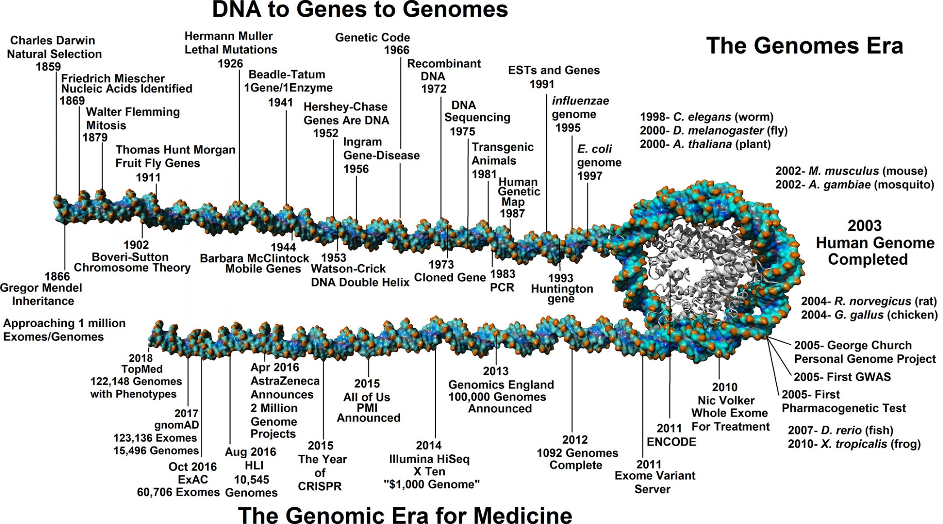
DNA to Genes to Genomes
J.W. Prokop et al Physiological Genomics 2018, 50, 563-579.

Slide 2
Growth of Gene-Phenotype Relationships
29 December 2017
Phenotypic Expansion
Structure-Function
Classical
LOF & GOF
Source: Ada Hamosh, Online Mendelian Inheritance in Man

Slide 3
The cost of understanding genetic disease: From Phenotype to Genotype and Back to Phenotype
J Liu, P Campeau, & B Lee New England Journal of Medicine 2014

Slide 4

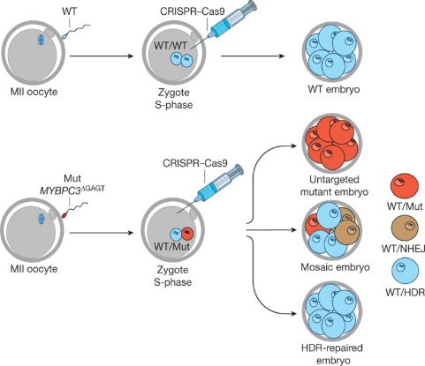
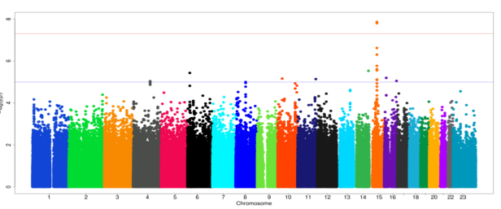
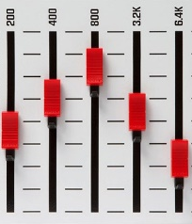
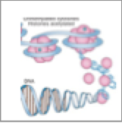
Genes, Genomes and Genetic Variation
Future prospects: Correcting pathogenic mutations?
Phenotype
Genetic Variation
Complex Disorders
Carroll
*
Sham
H Ma et al. Nature 1–7 (2017)
Monogenic Diseases
Christodoulou
Genotype

